Slide 1
Using human behavior to
understand monkey physiology
Dan Birman
2016-02-16
Frisem

Slide 2
What is it like to be a monkey?

Slide 3
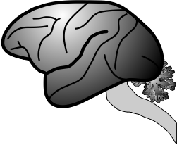
What is it like to be a monkey?

Slide 4
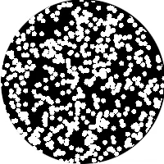
What is it like to be a monkey?

Slide 5
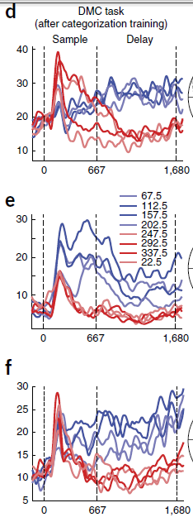
What is it like to be a monkey?

Slide 6
What is it like to be a monkey?

Slide 7
What is it like to be a monkey?

Slide 8
What is it like to be a monkey?
prospective student

Slide 9


Slide 10
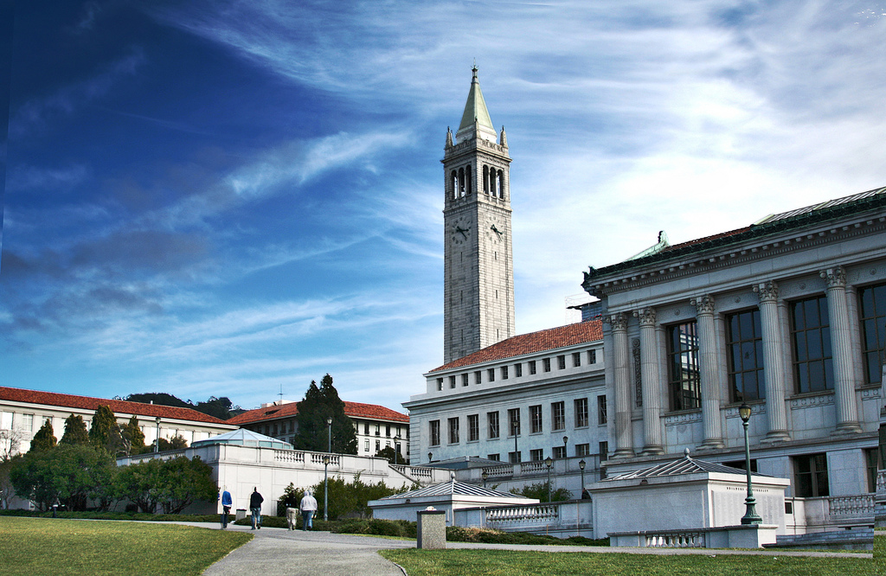

Slide 11
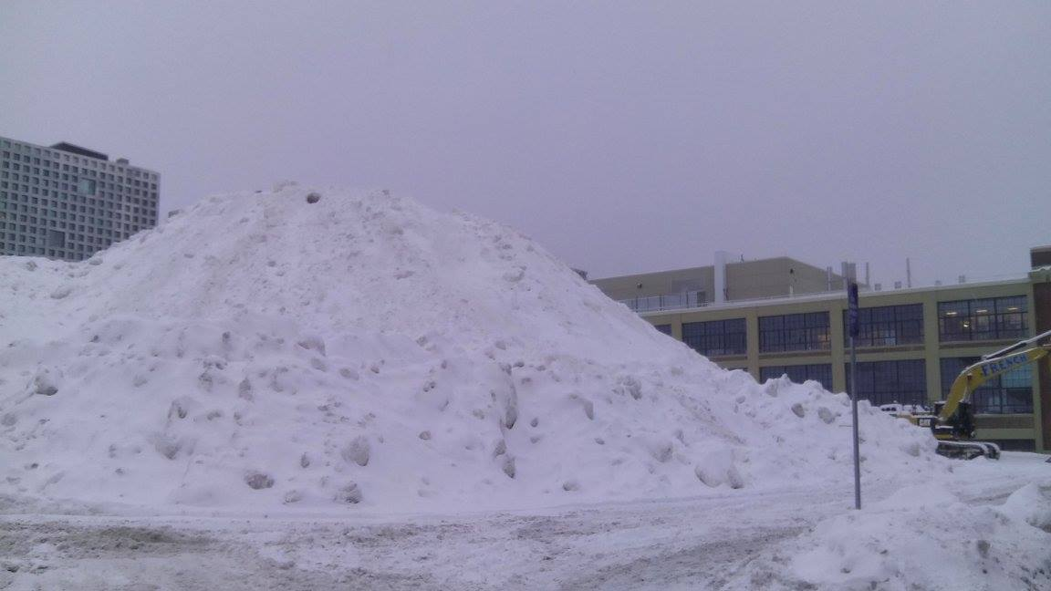

Slide 12



Slide 13
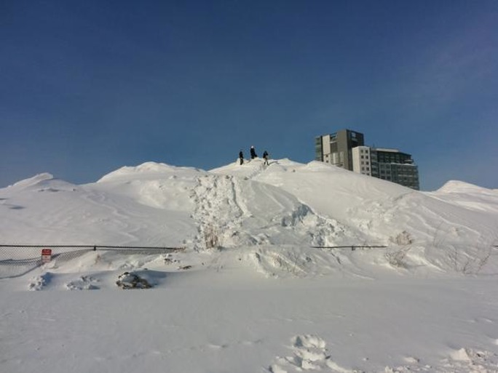

Slide 14
Criteria: Weather

Slide 16
Criteria: # of Faculty

Slide 17
Criteria: In the US?

Slide 18
What is it like to be a monkey?
prospective student

Slide 19
What is it like to be a monkey?
prospective student

Slide 20
What is it like to be a monkey?
prospective student

Slide 21


What is it like to be a monkey?
prospective student

Slide 22


What is it like to be a monkey?
prospective student

Slide 23
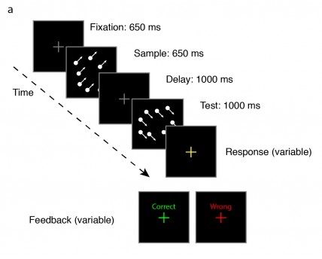

Slide 24
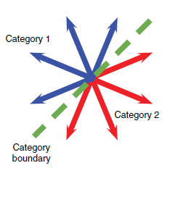

Slide 25
Categorization

Slide 26
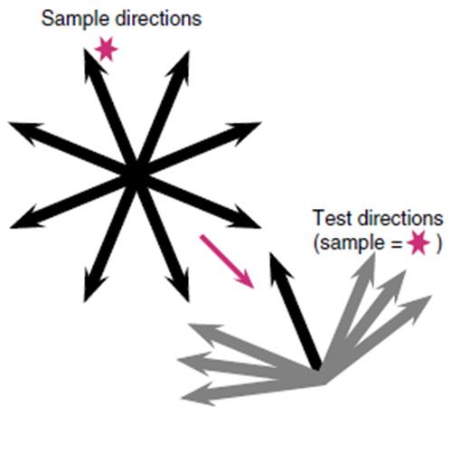
Categorization

Slide 27
Match to
Sample
Categorization

Slide 28
What is it like to be a monkey?

Slide 29
What is it like to be a …
monkey LIP neuron
doing categorization?

Slide 31
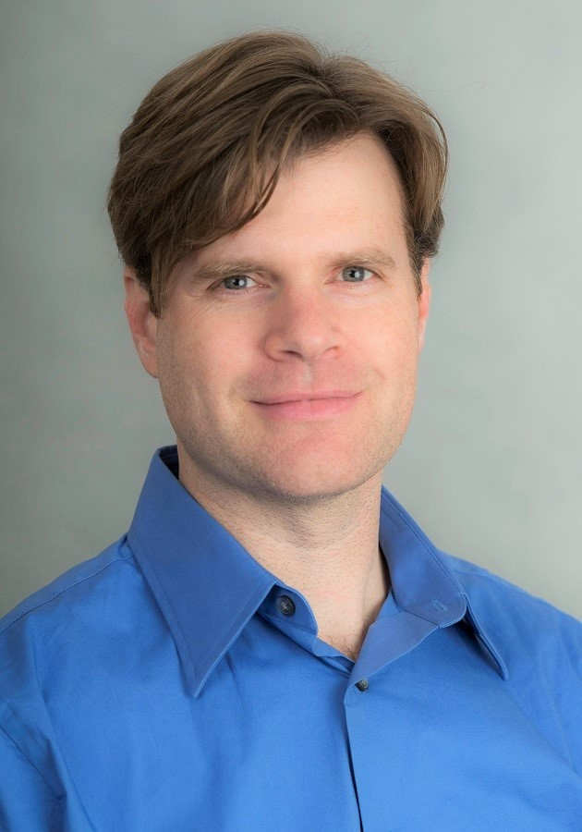
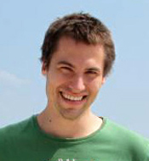
Arup Sarma, Nick Masse, X Wang, David Freedman @ U Chicago
David Freedman
Nick Masse

Slide 34
Sarma et al. 2016

Slide 36
Sarma et al. 2016

Slide 38
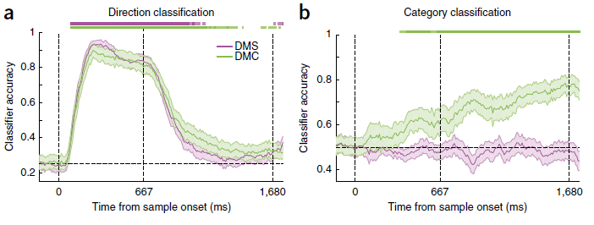

Slide 40
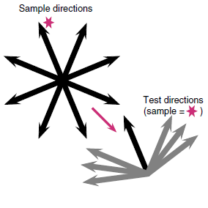
Sarma et al. 2016

Slide 41
What is it like to be a …
monkey LIP neuron
doing sample matching?

Slide 42
Sarma et al. 2016

Slide 43
Sarma et al. 2016

Slide 44
Sarma et al. 2016

Slide 45
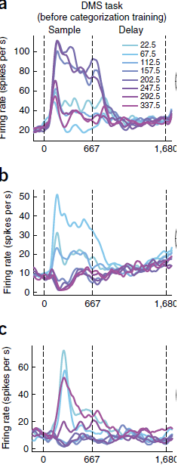

Slide 48

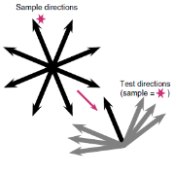
Match to Category
Match to Sample

Slide 49
What is it like to be a
monkey LIP neuron?

Slide 50
What is it like to be a
monkey LIP neuron?

Slide 51
What is it like to be a
monkey LIP neuron?

Slide 52


What is it like to be a
monkey LIP neuron?

Slide 53
What is it like to be a
monkey doing this task?

Slide 54
What is it like to be a
monkey doing this task?
human

Slide 55
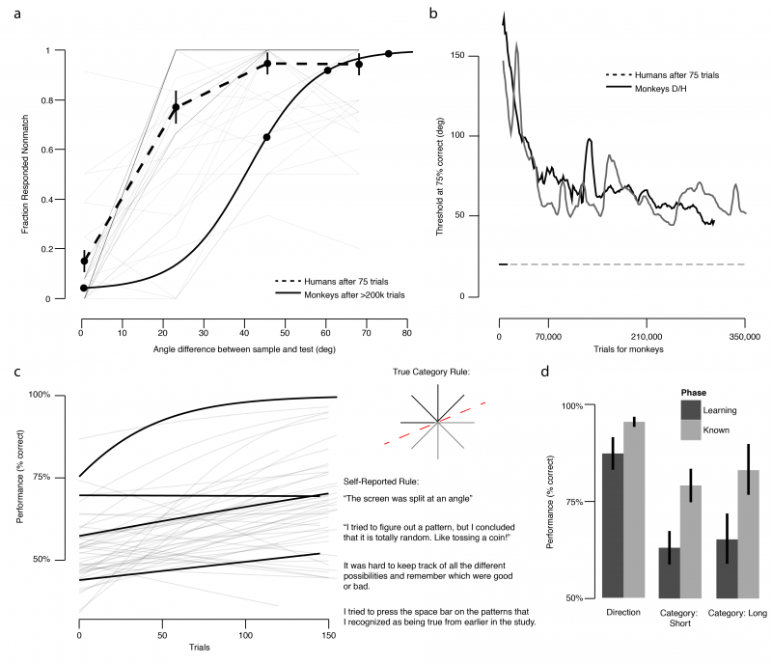

Slide 57
Threshold
~75% correct

Slide 67
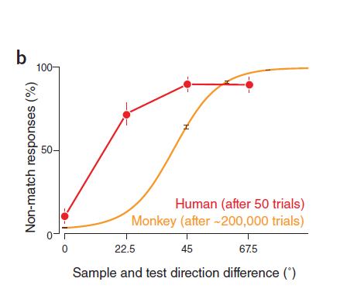
Birman & Gardner, Nat Neuro (2015)

Slide 68
Birman & Gardner, Nat Neuro (2015)

Slide 69
Birman & Gardner, Nat Neuro (2015)

Slide 70
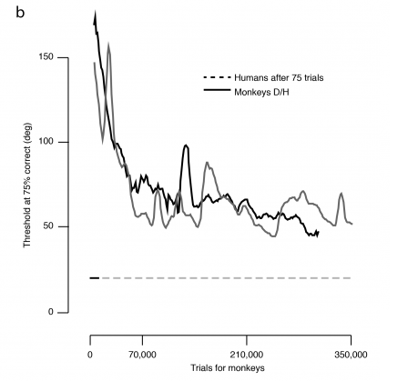

Slide 72
Human Performance (75 trials)

Slide 74
What is it like to be a
monkey doing this task?

Slide 75
What is it like to be a
monkey doing this task?

Slide 76
What is it like to be a
monkey doing this task?

Slide 77
What is it like to be a
monkey doing this task?

Slide 78
What is it like to be a
monkey doing this task?
We are using human behavioral data
to validate models of monkey physiology

Slide 79

Thank you!
Justin Gardner
Freedman Lab @ U Chicago
Nick Masse
David Freedman

